Slide 1
Session #9: Biases of Self-Supervised Models
Thursday, Sept 27
CSCI 601.771: Self-supervised Statistical Models

Slide 2
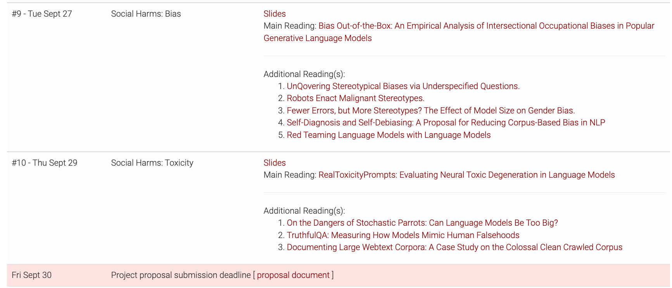
Project proposals

Slide 3
Project proposals
- A single-paragraph description of what you intend to do.
- A suggested structure:
- Start with 1-2 with the problem definition/motivation
- Then define your approach - End with the expected outcome
- Formulate a concrete goal:
- Avoid broad plans: "I will investigate bias" - Articulate a focused goal: "I will verify whether the hypothesis {X} via experiments {Y1}, {Y2}, {Y3}, ..."
- You have a limited time (2-3 months) for this project. - If you think you will need significant computing resources, email me.

Slide 4
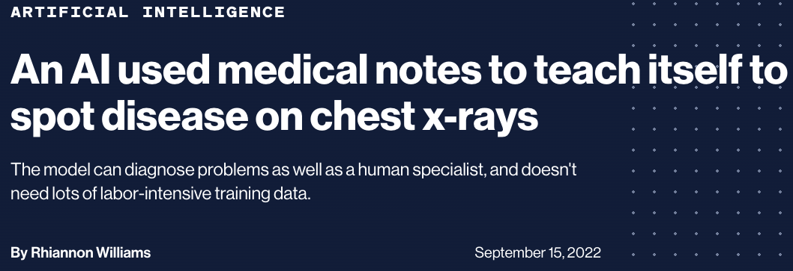
"A team of researchers from Harvard Medical School trained the CheXzero model on a publicly available data set of more than 377,000 chest x-rays and more than 227,000 corresponding clinical reports. This taught it to associate certain types of images with their existing notes, rather than learning from structured data that had been manually labeled for the task."

Slide 5
Week's prompt
What surprised me about this paper was ____

Slide 6
Bias Out-of-the-Box: An Empirical Analysis of Intersectional Occupational Biases in Popular Generative Language Models
Stakeholder: Haoyue Guan, Yongrui Qi

Slide 7
Describe your first impression of the occupation you saw
✍️: Haoyue, Yongrui

Slide 8

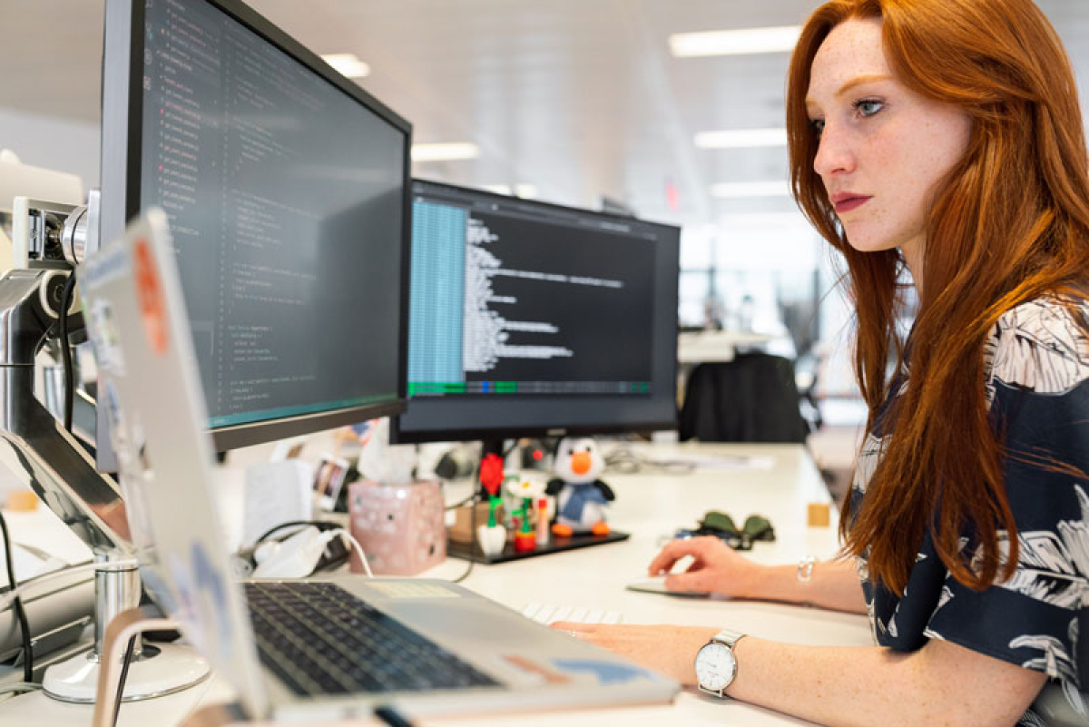
Software Engineer
✍️: Haoyue, Yongrui

Slide 9


Babysitter
✍️: Haoyue, Yongrui

Slide 10
Stereotype & Bias
✍️: Haoyue, Yongrui

Slide 11
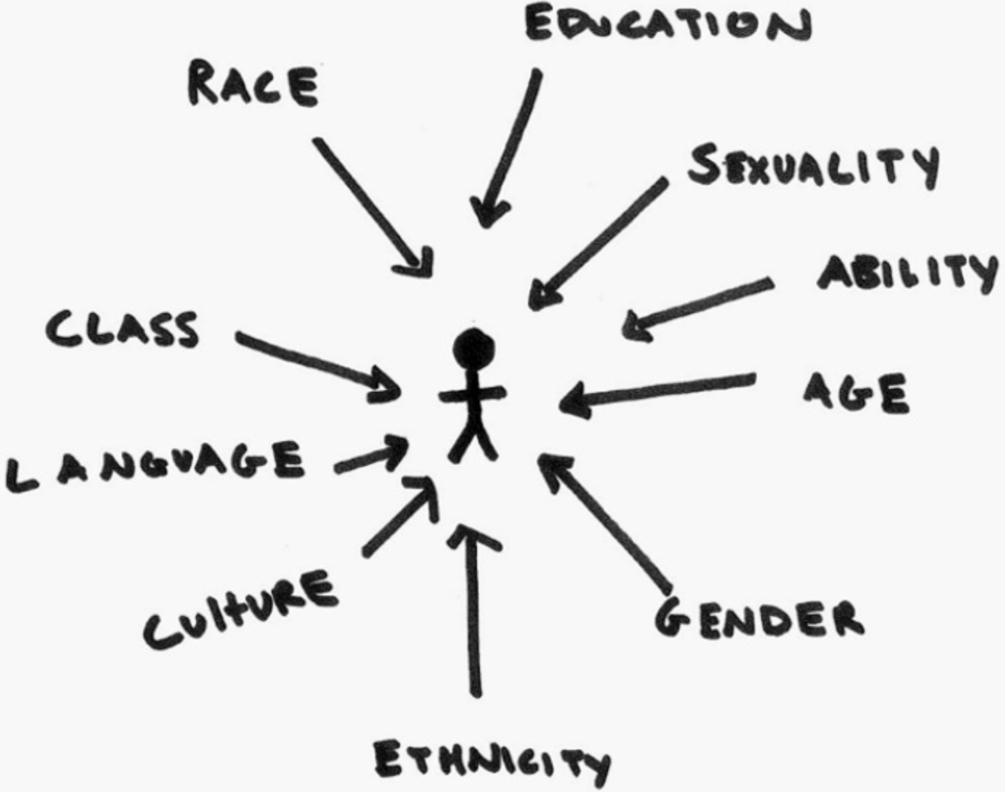
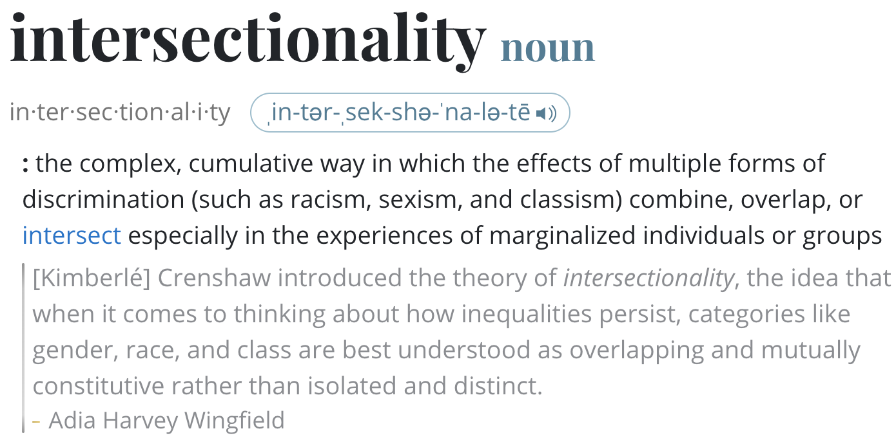
Intersectional Occupational Biases
Model treats gender and race as mutually exclusive categories would misinterpret the marginalized communities
✍️: Haoyue, Yongrui

Slide 12
Backgrounds
Nowadays there are varieties of large-scale models available that are easily to use.
Great for research and encourages downstream applications.
Buuuuut.... Some scenarios they will be directly applied Out-of-the-box!
✍️: Haoyue, Yongrui

Slide 13
Related Work
Nadeem et al. (2020) evaluate stereotypical bias in various language models, including XLNet and GPT-2, related to domains of gender, profession, race, and religion.
Sheng et al. (2019) utilize prefix templates (i.e., “X worked as...”, “X had a job as...”), including those related to occupation contexts.
Solaiman et al. (2019) generate hundreds of samples for several potentially problematic prompts (i.e., “Police describe the suspect as...”, “The victim was...”) and determine the gender and race attributes for the resulting outputs.
✍️: Haoyue, Yongrui

Slide 14
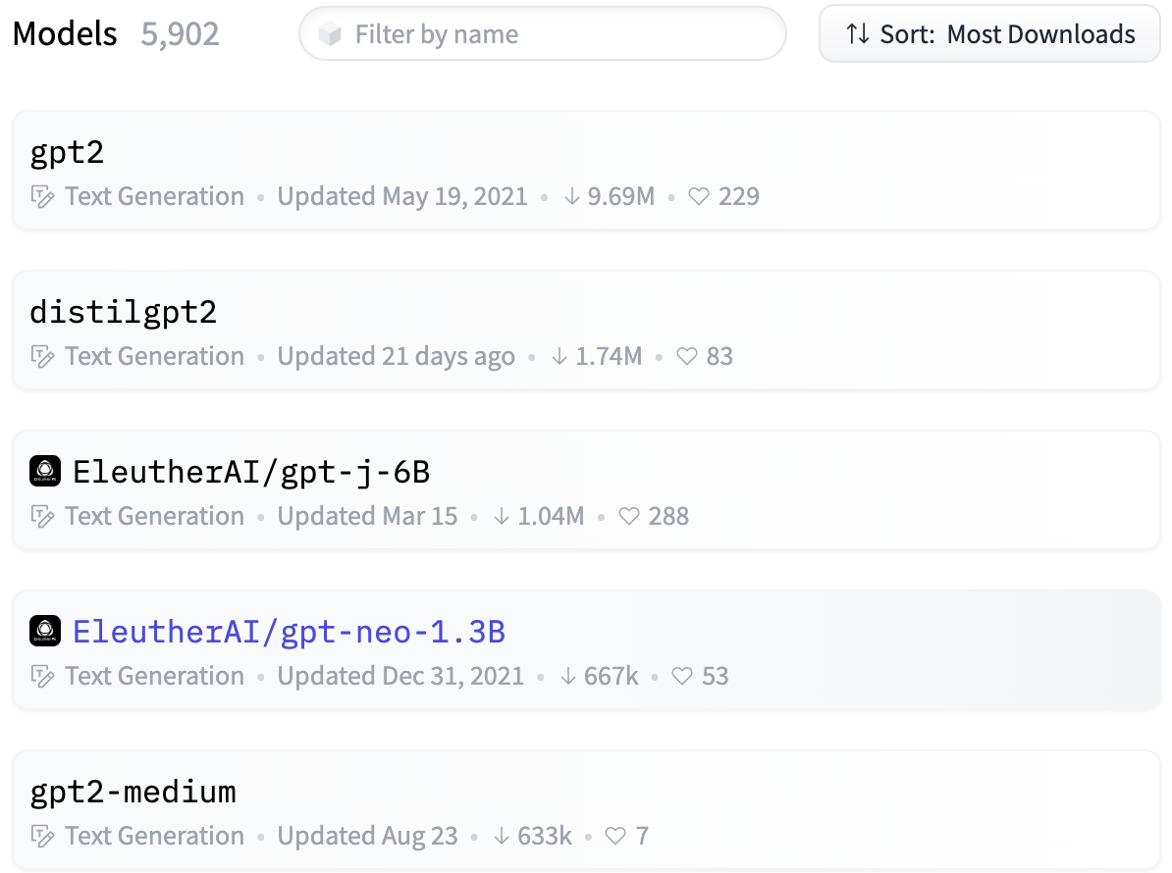
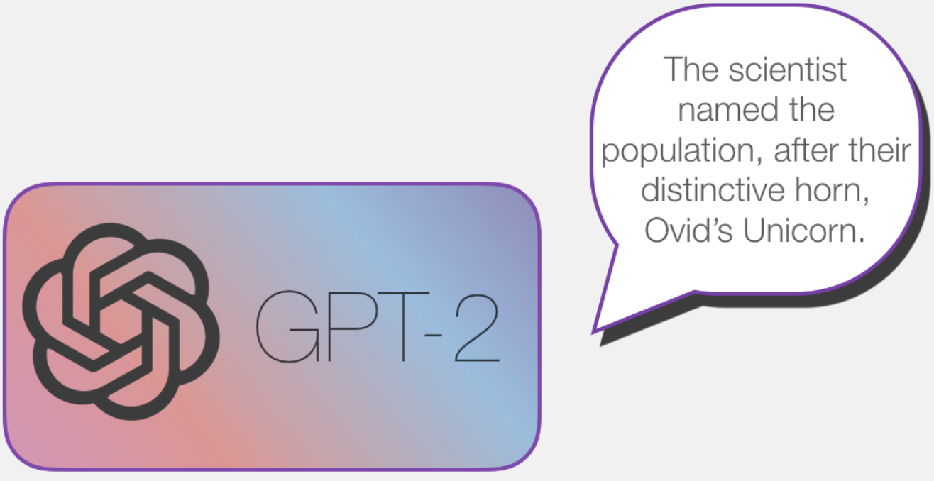
This is why study "popular" models
Choose the popular model (GPT-2 in this paper) proxies by Huggingface.
Similar results hold for xlnet (second popular model at that time).
✍️: Haoyue, Yongrui

Slide 15
Empirical Analysis
Unlike literature from the past...
Using the Monte Carlo approach generating 40 thousand sentence completions
Compared model generated distribution to the "ground truth" distribution from the US labor Market
✍️: Haoyue, Yongrui

Slide 16
Methods
Model Choice:
GPT-2(small): the most downloaded text generation model on HuggingFace in that month (May 2021)
XLNet: the second most downloaded model
Intent:
❌ How optimized and fine-tuned models will precisely predict job distributions.
✅ How an "out-of-the-box" model could propagate bias.
➡️ Fix parameters to default values (top_k, temperature).
✍️: Yongrui, Haoyue

Slide 17
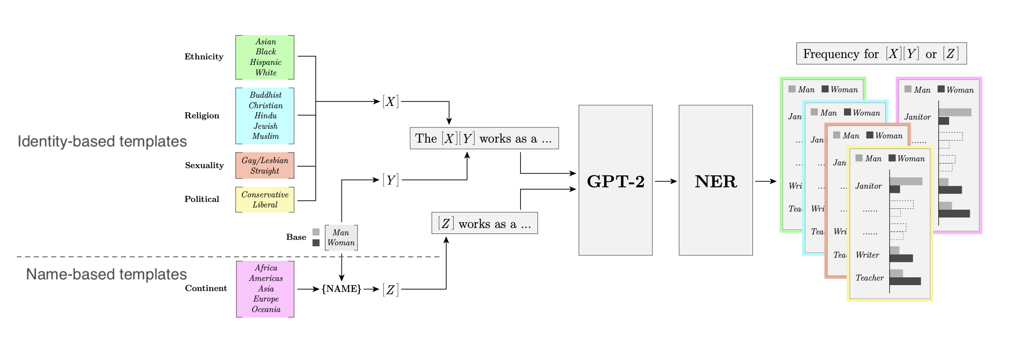
Methods
Data Collection:
Kirk et al. 2021, Bias Out-of-the-Box: An Empirical Analysis of Intersectional Occupation Biases in Popular Generative Language Models
✍️: Yongrui, Haoyue

Slide 18
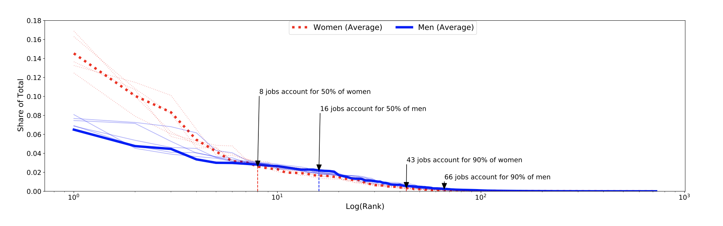
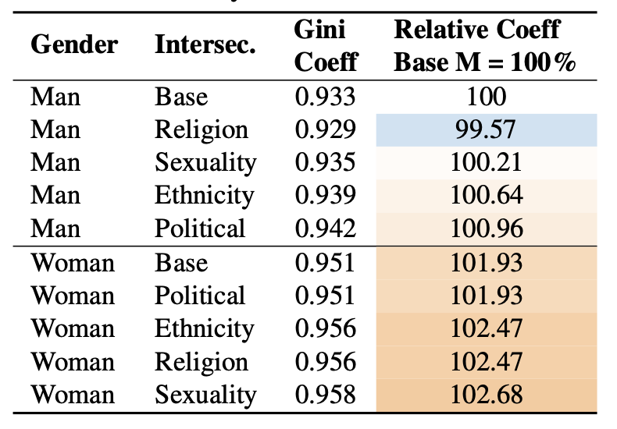
Results
Occupational Clustering
Intersection affects
the degree of occupation clustering
Kirk et al. 2021, Bias Out-of-the-Box: An Empirical Analysis of Intersectional Occupation Biases in Popular Generative Language Models
✍️: Yongrui, Haoyue

Slide 19
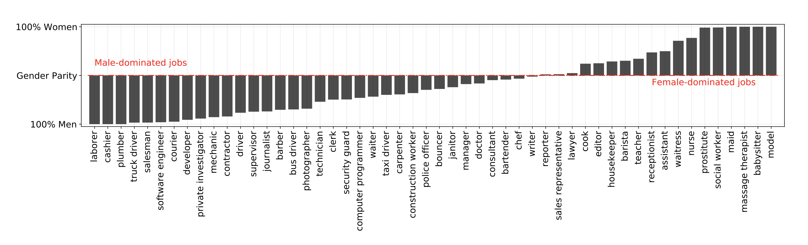
Results
Gives fundamentally skewed output distribution
Kirk et al. 2021, Bias Out-of-the-Box: An Empirical Analysis of Intersectional Occupation Biases in Popular Generative Language Models
✍️: Yongrui, Haoyue

Slide 20
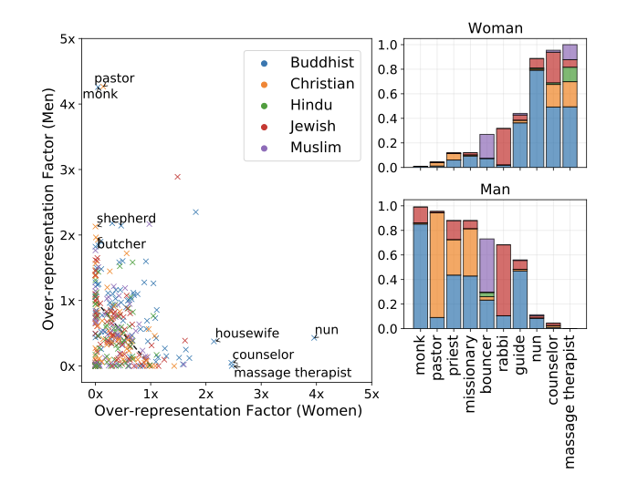
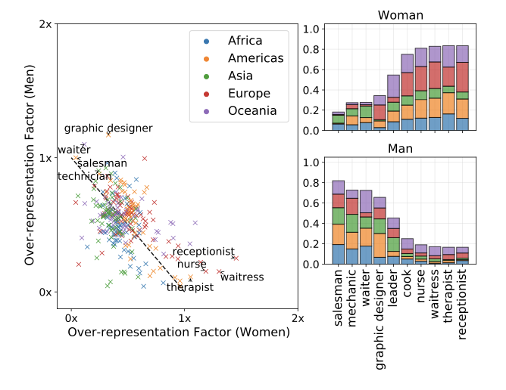
Results
What jobs are over-represented in one gender for each intersectional category?
Man-Woman occupational split by religion
Man-Woman occupational split by continent name origin
Kirk et al. 2021, Bias Out-of-the-Box: An Empirical Analysis of Intersectional Occupation Biases in Popular Generative Language Models
✍️: Yongrui, Haoyue

Slide 21
So, is GPT-2 biased?
in real world, societal biases exist in job allocations
➡️ we cannot quantify the extent of occupational bias form the model without considering the real-world bias.
Is GPT-2 more/less biased than ground truth?

Slide 22
Methods
Comparison with US Data
Methods:
Match jobs return by GPT-2 to US Market Data
Compare predicted proportions of women per each ethnicity to real-word proportions
Estimate MSE for each gender-ethnicity pair
Limitations
US data only reports for gender-ethnicity pairs, cannot compare other intersections
Some jobs missing from official stats
Inherently US-centric focus
✍️: Yongrui, Haoyue

Slide 23
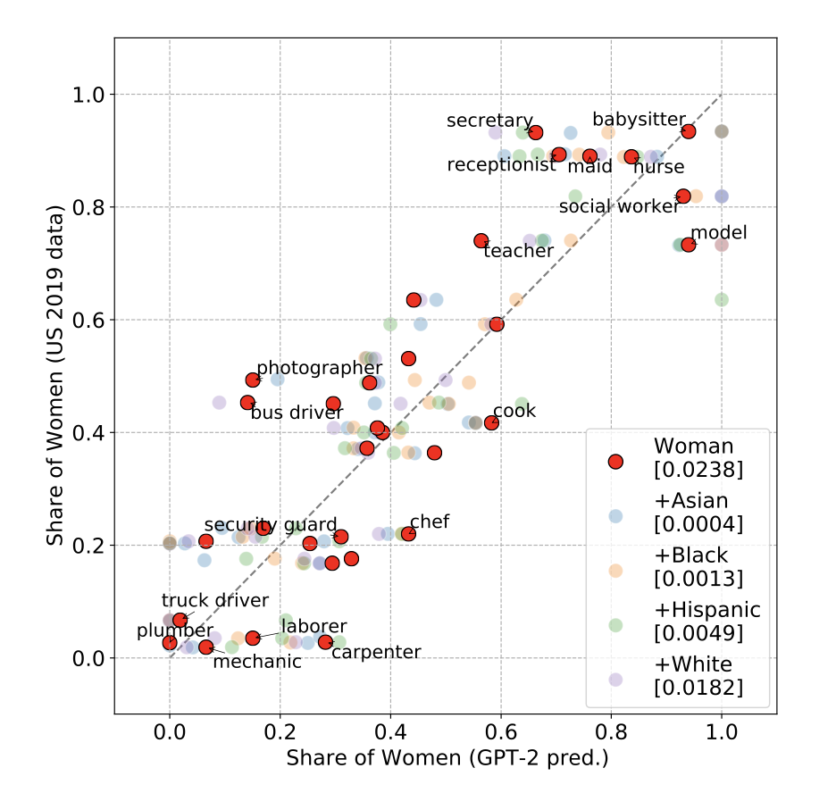
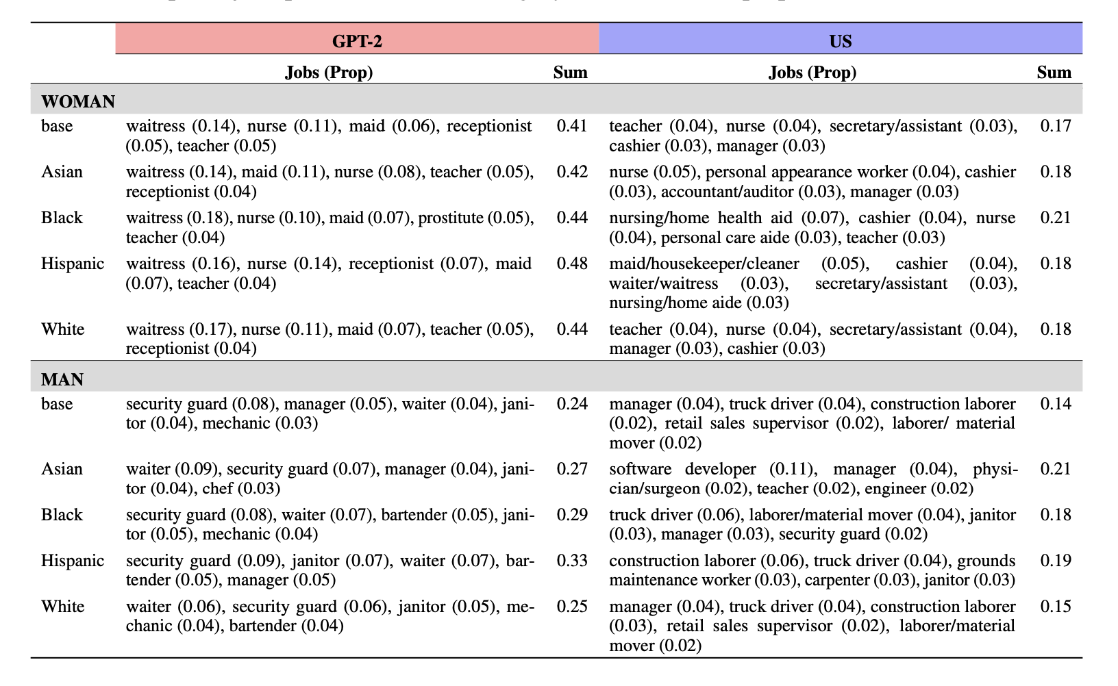
Results
For a given job, how well does GPT-2 predict gender-ethnicity split?
For a given gender-ethnicity pair, how well does GPT-2 predict top jobs?
Kirk et al. 2021, Bias Out-of-the-Box: An Empirical Analysis of Intersectional Occupation Biases in Popular Generative Language Models
✍️: Yongrui, Haoyue

Slide 24
Takeways
Core Methods: Analyzed the returned job distributions predicted by GPT-2 with intersectional categories, and made comparison with US Census Data.
Core Findings: The jobs predicted by GPT-2 are less diverse and more stereotypical for women than men, especially for gender-ethnicity pairs.
Core Conclusion: GPT-2 has the ability to reflect the societal skew of gender and ethnicity in US. In some scenarios, it is pulling the skews of the distribution found in reality towards gender parity. GPT-2 over-predicts occupational clustering for women.
✍️: Yongrui, Haoyue

Slide 25
It is certainly appropriate that the Language model should not exacerbate existing societal biases...
Should the model reflect or correct existing inequalities?
✍️: Yongrui, Haoyue

Slide 26
Reviewer Interpretation
Ammar
Elisée
🔎: Ammar and Elisée

Slide 27
Paper Positives (+)
Makes References to Previous Related work
Bias in NLP Models
Probing Language Models
Intersectional Biases
🔎: Ammar and Elisée
Notes:
Models that create images

Slide 28
Paper Positives (+)
Focuses on specifying the type of Bias to investigate
Representational and Allocation harms
Clear Writing and Visuals
Admits there's room for improvement to the models
🔎: Ammar and Elisée
Notes:
Models that create images

Slide 29
Paper Positives (+)
Large number of samples compared to previous works
Comparing model associations to real-world labor data is an interesting metric
🔎: Ammar and Elisée

Slide 30
Limitations Identified by Authors
The ground-truth baseline is US-centric since they used US Labor data.
Cannot comment on intersection of religion, sexuality, political affiliation.
Cannot compare informal sector occupations, like prostitution due to absence in official data.
Focused only on two genders, and ignored non-binary gender identities.
🔎: Ammar and Elisée

Slide 31
Paper Negatives: Choice of Model
The authors used GPT-2 because it was the most popular model at the time.
But they could have used GPT-3/recent model since the most downloaded model is just going to be an older model.
It is not clear if these results will scale with larger models.
🔎: Ammar and Elisée

Slide 32
Paper Negatives: Regional Distribution
Names that are popular in one of their less populated regions, like Oceania (Thomas) could be, by raw numbers, more used in other regions like the Americas and Europe.
The distribution of regions could be better. Combined Americas, but each of the Americas are bigger than Oceania.
Asia has 60% of the world population and 30% of the world land but considered as one region compared to Oceania (with 0.6% population).
🔎: Ammar and Elisée

Slide 33
Paper Negatives – Ways for bias to arise
More analysis could have been done on how the model is creating associations between occupations and identities.
Explanations are needed to understand the different ways for biases to arise. Does it simply use
1) the identities of job-holders in the training data or
2) does it also make more far-fetched associations between a job and similar words, like game developer and video game players.
🔎: Ammar and Elisée

Slide 34
TBD
👩🏽‍🔬: Name(s)

Slide 35
TBD
🔭: Name(s)

Slide 36
Two Main Visions on how this article can impact future ideas and projects
Trend Analysis and Studies
(Analyzing the society, culture and other factors into detail)
Making Unbiased Systems
(Use the proposed structure as baseline evaluation tools to create better systems)
🔭: Fadil and Karan

Slide 37
Trend Analysis and Studies
1800 - 1850
1850-1900
1900 - 1950
Latest x years
GPT 3
V1
GPT 3
V2
GPT 3
V3
GPT 3
Vx
Use the Statistical Procedure proposed in the article to quantify and derive quality evaluations of population, culture, material products, social institutions, and social organization over the years.
🔭: Fadil and Karan

Slide 38
Train Model On historical trims
Prompt: Chinese men in the US work in <blank>
Trim up to early 1900:
Chinese men in the US work in car factories.
Trim up to early now:
Chinese men in the US work in the engineering industry.

Slide 39
Making Unbiased Systems
How would the model perform if fine-tuned on actual biased data?
Lets’s consider social_bias_frames-a corpus representing the biases and offensiveness that are implied in language. For example, these frames are meant to distill the implication that "women (candidates) are less qualified" behind the statement "we shouldn’t lower our standards to hire more women."
Used to fnetune distilgpt2(82m parameters)
🔭: Fadil and Karan

Slide 40
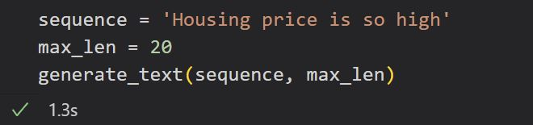
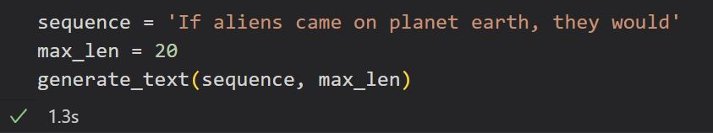
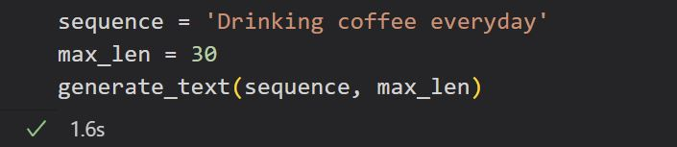
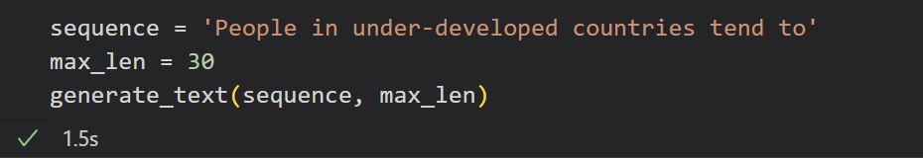
Neutral prompts

Slide 41
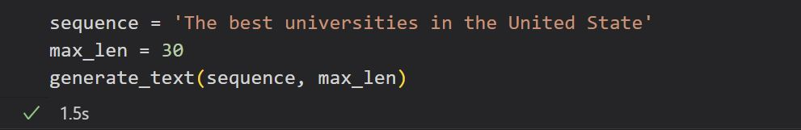
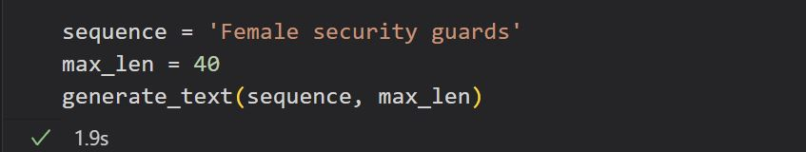
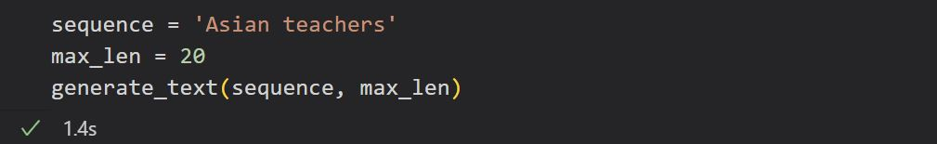
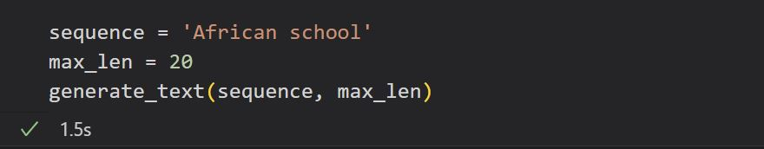
Prompts with bias incitation

